Slide 1
Using K-Means Clustering and Geospatial Mapping to Predict Crime Hotspots in Denver
Christopher Seven

Slide 2
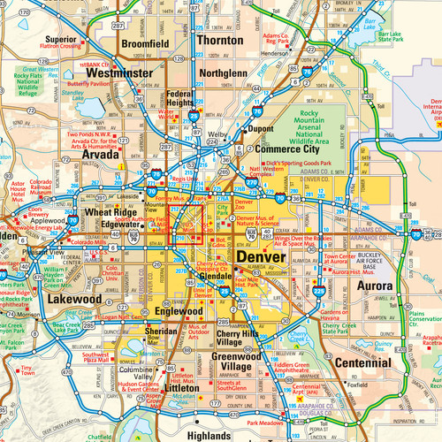
Research Question
Using machine learning, can patterns of crime be identified and predicted within Denver?

Slide 3

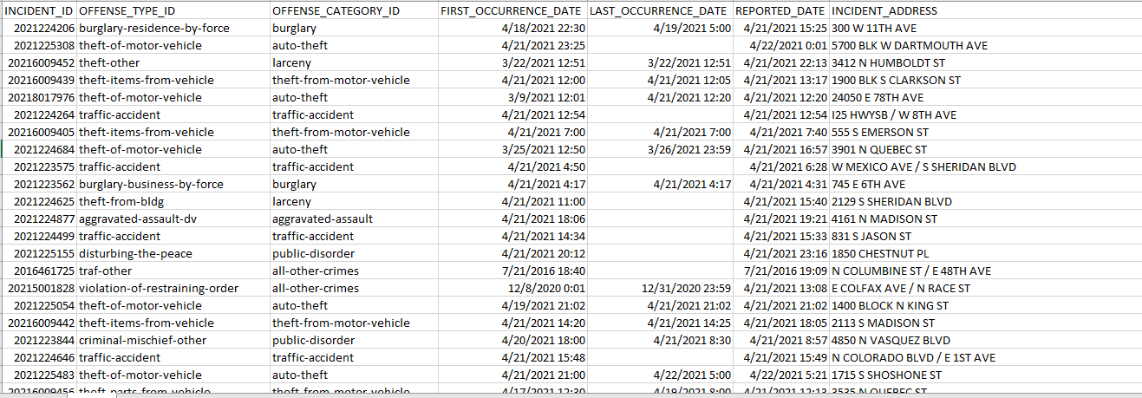
Dataset Used – Denver Open Data Catalog: Crime 2016 - now

Slide 4
Purpose
Group data points in proximity together to identify patterns
Methodology
K-Means Clustering
01
Choose a k as the number of centroids to cluster around
02
Randomly pick points as the centroids and calculate sum of squared differences
03
Adjust the position of the centroids and recalculate SSD
04
Continue until max iterations or SSD does not change

Slide 5








Research Project Methodology
Separate data into specific categories (murder, arson, auto theft)
Use the Elbow Method to find the optimal k for k-means clustering
Plot clusters onto shapefile over crime data points by crime type
Download Denver Crime Dataset
1
2
3
4
5
6
7
8
2
Clean dataset in Python with Pandas
Identify clusters based on crime type using k-means clustering technique
Assess patterns and draw conclusions from Denver map
Use Denver shapefile to plot crime’s longitude and latitude

Slide 6

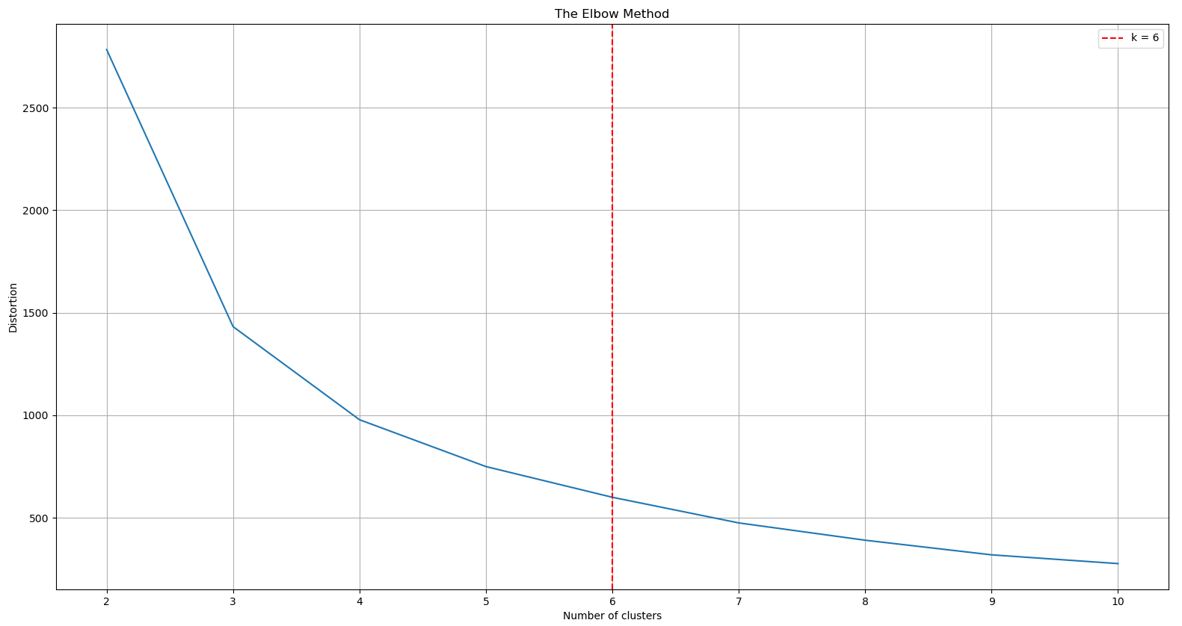
The Elbow Method
Used to find the optimal number of clusters k
Iterate through n clusters (typically 10) and find the distortion at each amount
Distortion is the average of squared differences from each centroid
Plot number of clusters by distortion and identify the “elbow”, or optimal k

Slide 7
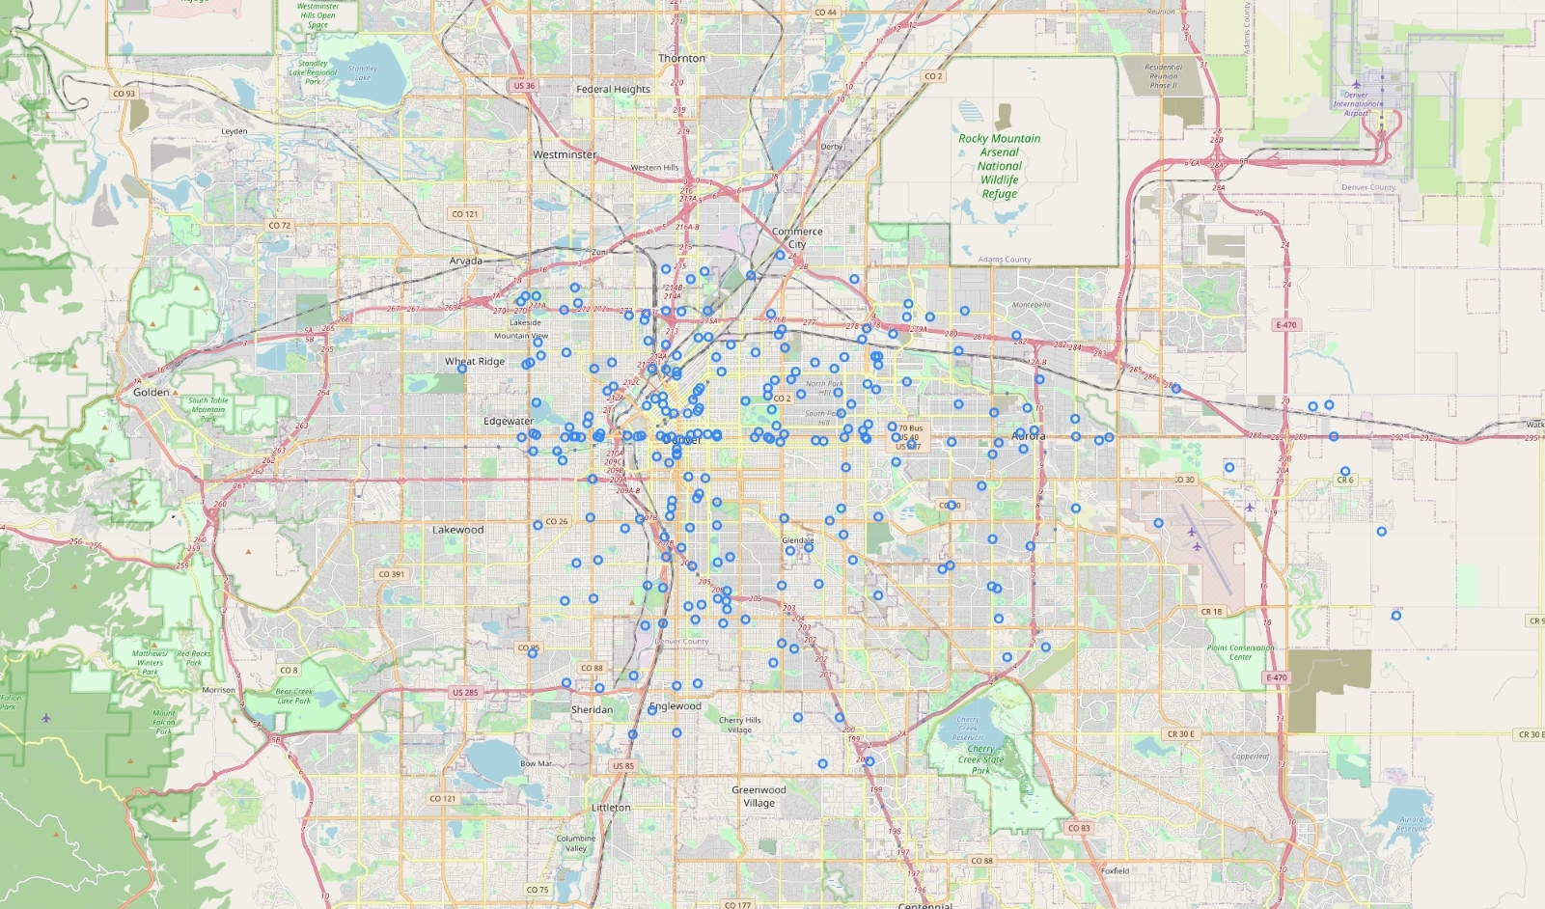
Geospatial Crime Mapping

Slide 8

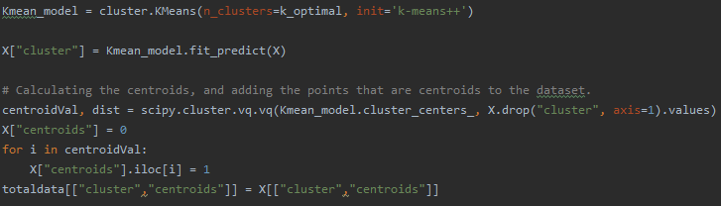
K-Means Clustering

Slide 9
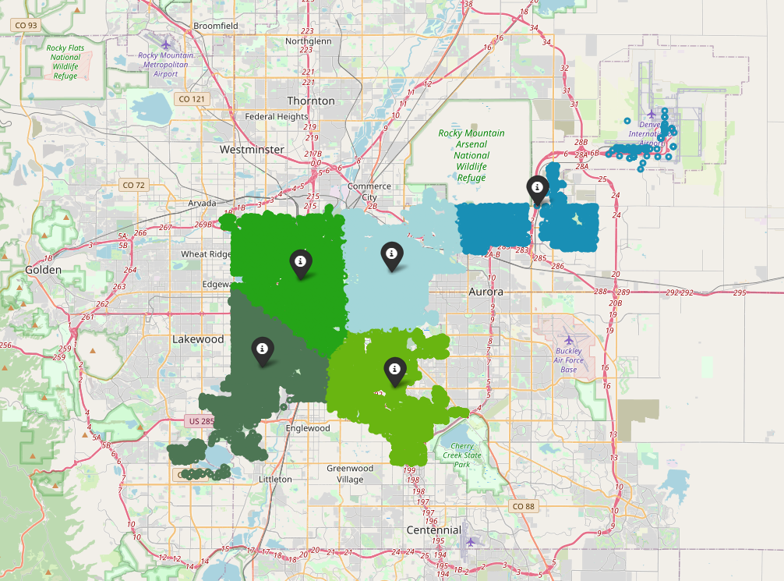
Geospatial Clustering – All Crimes
K: 5
Total: 55,151

Slide 10
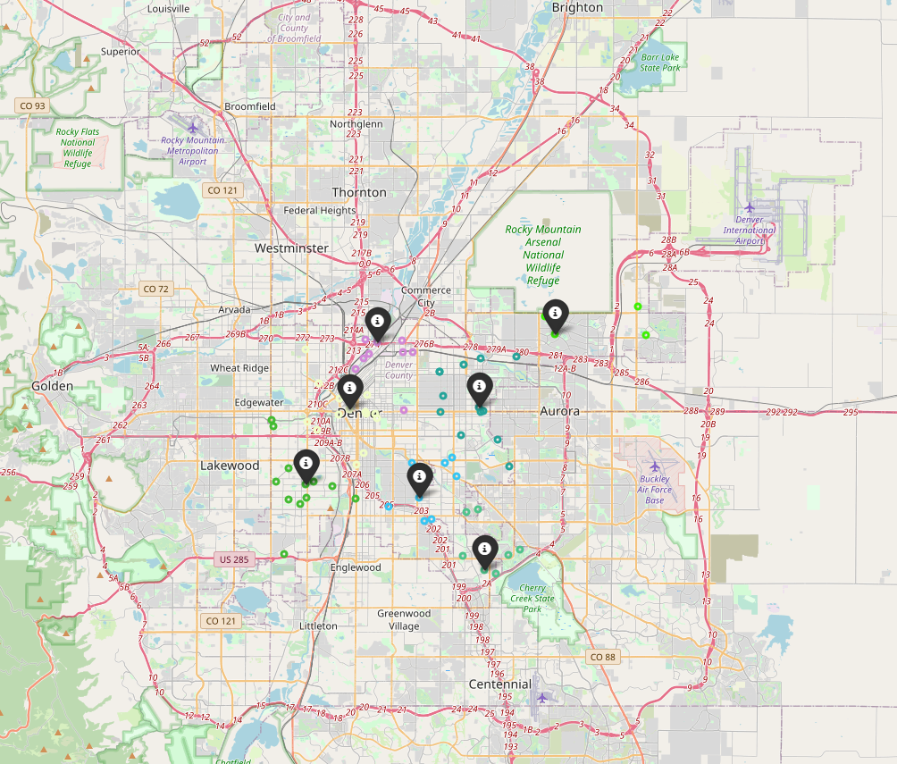
Geospatial Clustering – Murder
K: 7
Total: 69

Slide 11
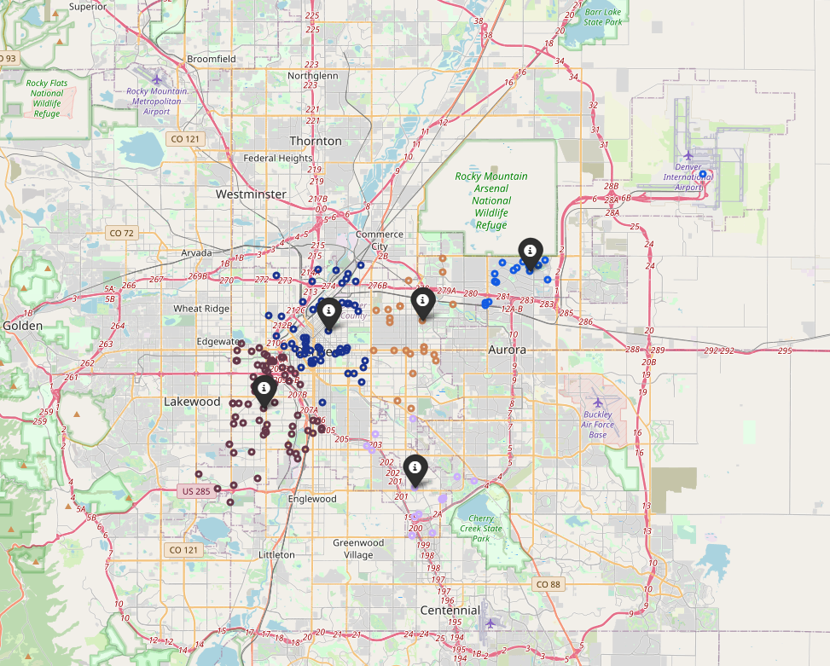
Geospatial Clustering – Arson
K: 5
Total: 183

Slide 12
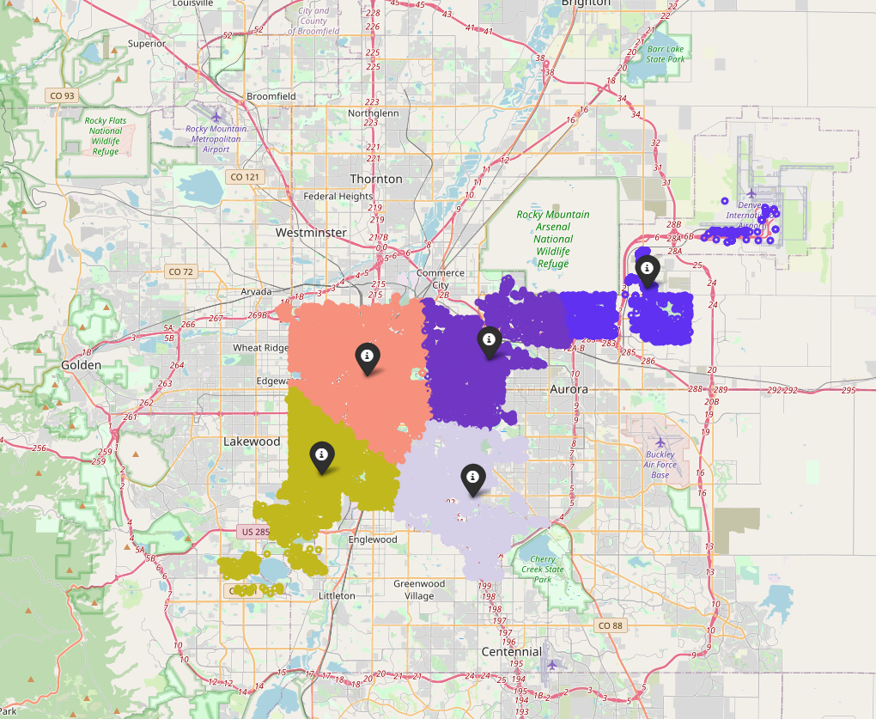
Geospatial Clustering – Auto Theft
K: 5
Total: 28,514

Slide 13
01
Number of Clusters
Every data set except for murder had 5 clusters – likely due to Denver’s geographic layout
02
Crime Distribution
Analysis & Predictions
It appears that crime is relatively equally distributed throughout Denver, higher volume in the RiNo and Colfax areas
03
Airport
Airport didn’t experience much crime besides auto theft
04
Future Predictions
Restrict datasets even further by time

